Slide 1
Precipitation Runoff Modeling System PRMS
Overview
Steve Markstrom
Lakewood, CO

Slide 2
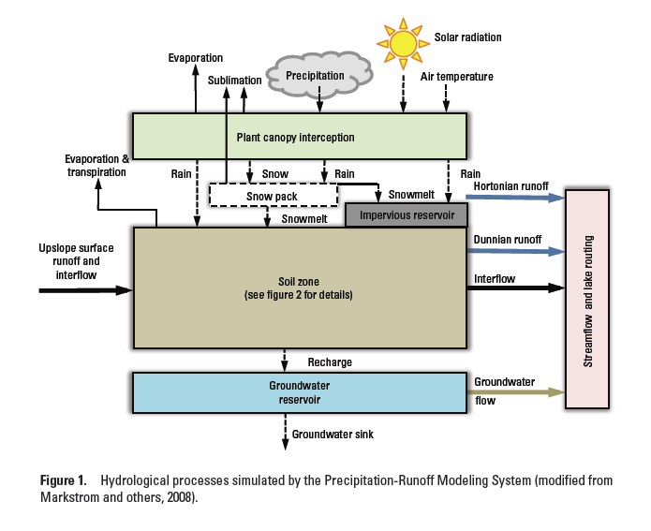
PRMS Conceptual Diagram

Slide 3
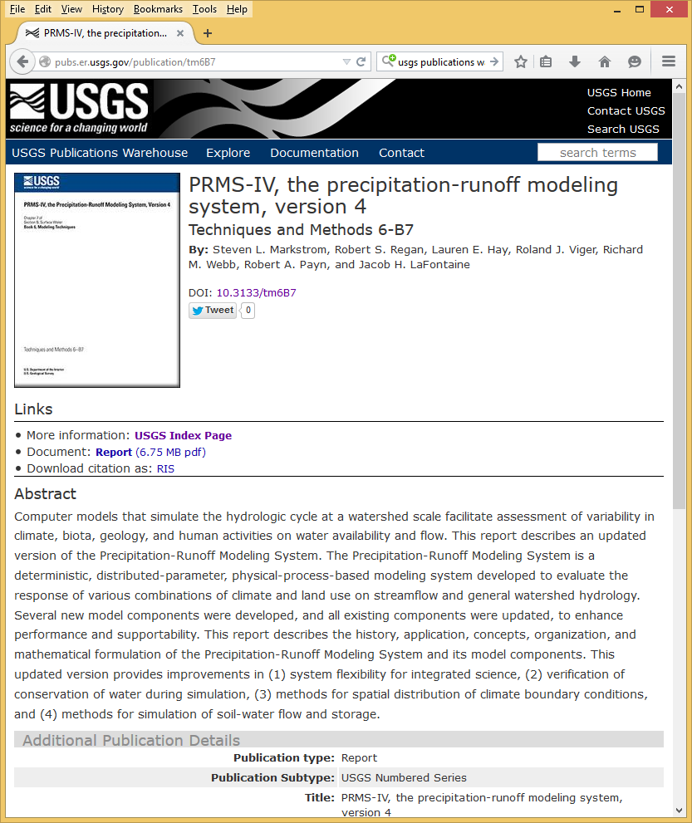
Documentation
Users’ manual
http://dx.doi.org/10.3133/tm6B7
or from “USGS Publications Warehouse”

Slide 4
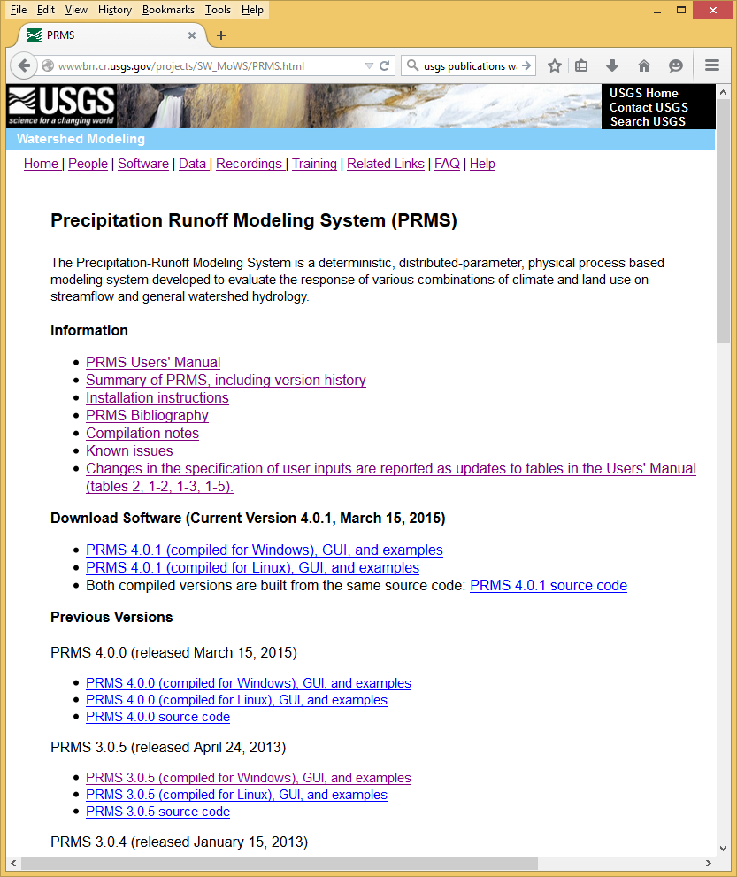
Documentation
Users’ manual
Web page
http://wwwbrr.cr.usgs.gov/prms

Slide 5
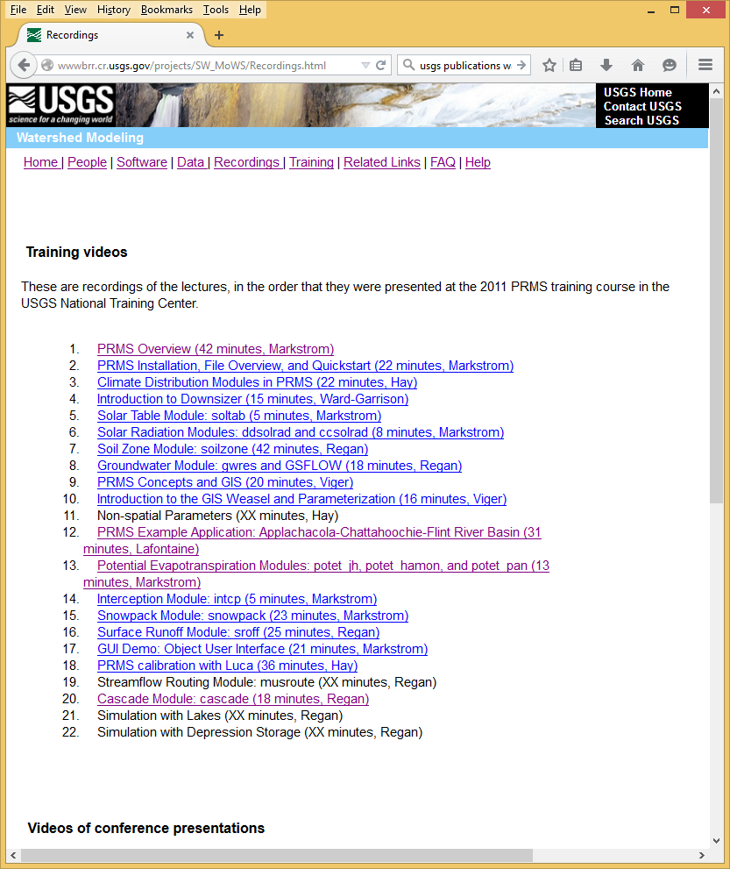
Documentation
Users’ manual
Web page
Training videos
http://http://wwwbrr.cr.usgs.gov/projects/SW_MoWS/Recordings.html

Slide 6
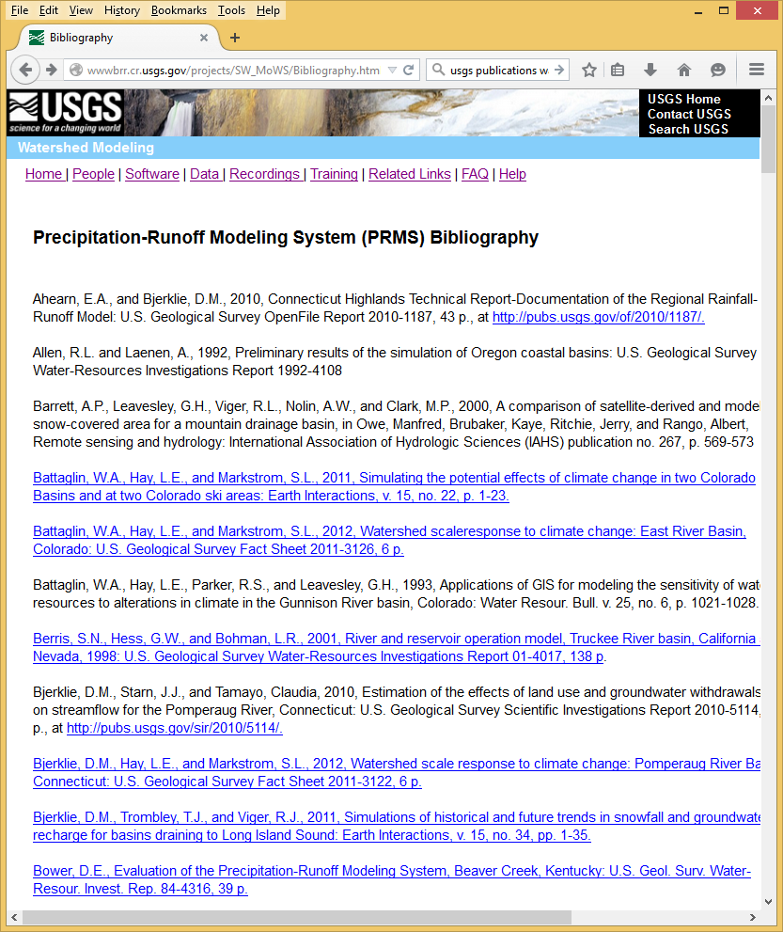
Documentation
Users’ manual
Web page
Training videos
Reports and articles (137)
http://wwwbrr.cr.usgs.gov/projects/SW_MoWS/Bibliography.html

Slide 7
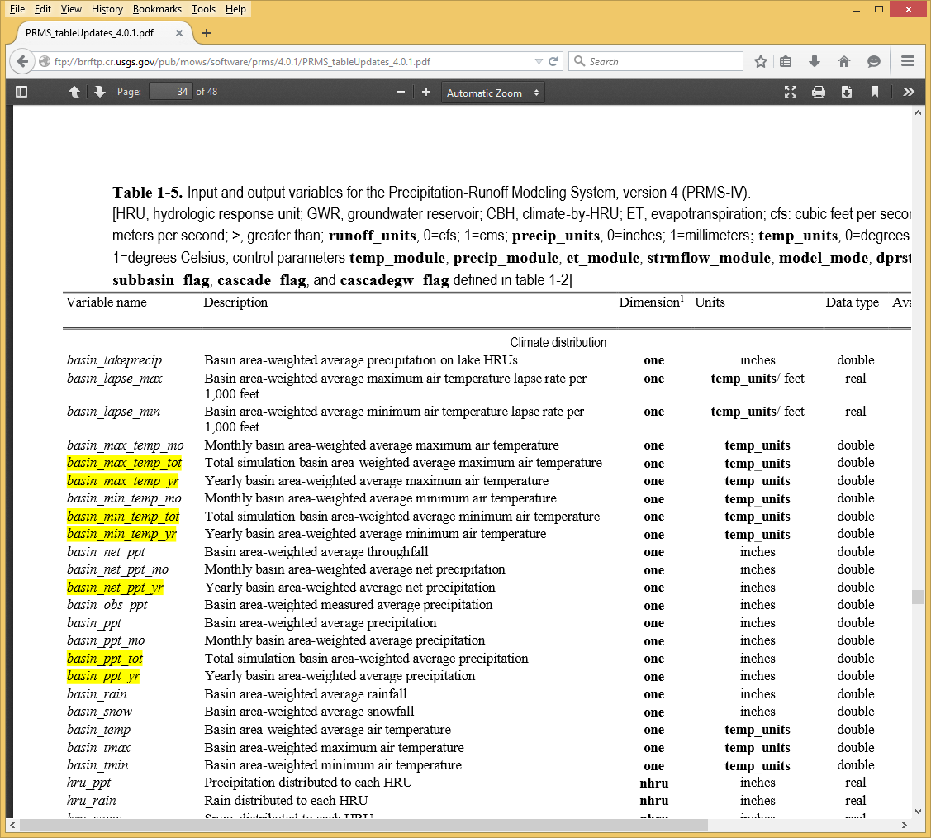
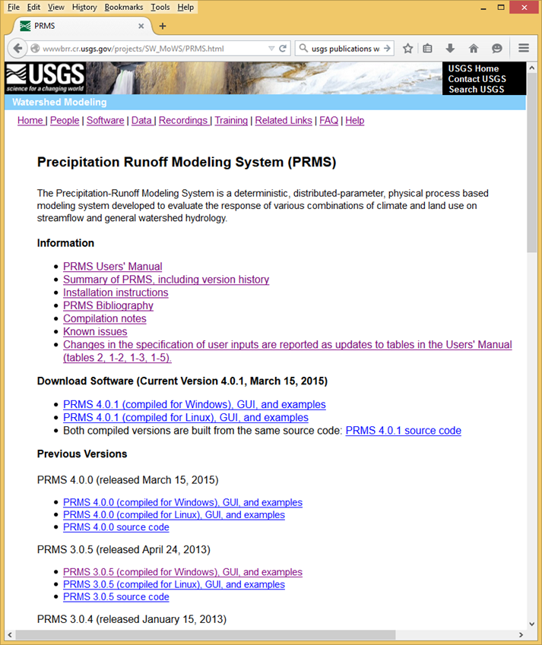
Documentation
Users’ manual
Web page
Training videos
Reports and articles (137)
Updates to tables (modules,
dimensions, parameters,
Variables)
http://wwwbrr.cr.usgs.gov/prms

Slide 8
Continuity Equation
ΔStorage = Inputs - Output - Error
Ground Water
Water Bodies
Snow & Ice
Soil Moisture
Precipitation
Stream Flow
Ground Water Flow
Evapotranspiration
Trans-basin Flow

Slide 9
Units used in PRMS
Storage (volumetric) Units: Inches (depth over area)
Example: snow pack
Flux (volumetric flow)Units: Inches (depth over area / time step)
Example: precipitation
This means that most continuity calculations reduce to simple additions or subtractions because “area” and “time step” cancel out and all that is left is “depth”

Slide 10
PRMS Scale
Spatial Scale: 10s to 10,000s km² (< 1 km² resolution)
Temporal Scale: 1s to 100s years (daily time step)

Slide 11
PRMS Discretization of Space
Model Domain
Stream Segments
Hydrologic Response Units
Subbasins

Slide 12
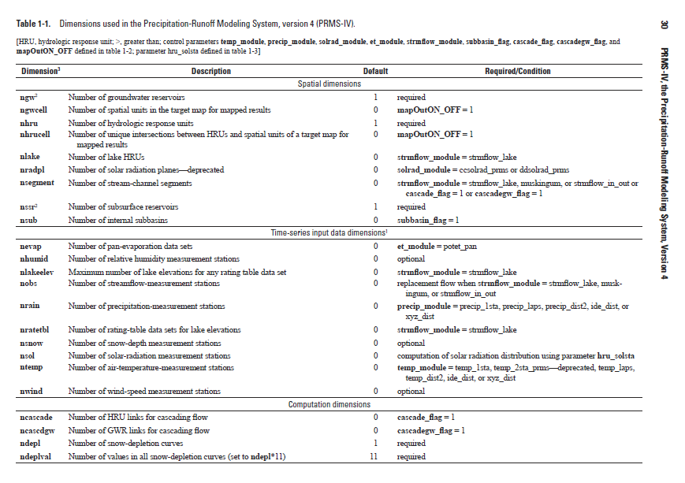
System Concepts: Dimensions
A value that is used to describe the array size (number of values) of a parameter or variable
Every parameter and variable has one or more dimensions associated with it
A dimension is comprised of a name and an integer value
Dimensions are read from the PRMS Parameter File

Slide 13
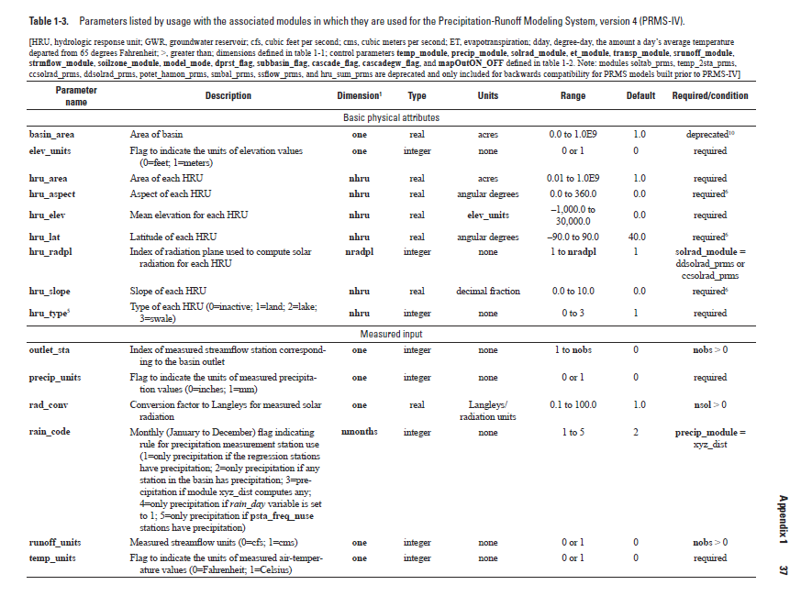
System Concepts: Parameters
A static input value that does not change during the course of a PRMS simulation
“Declared” by the active modules in PRMS
Must be declared as arrays -- scalar parameters have an array size of one
Values of each parameter are read from the PRMS Parameter File before the simulation starts
Real or integer numerical type

Slide 14
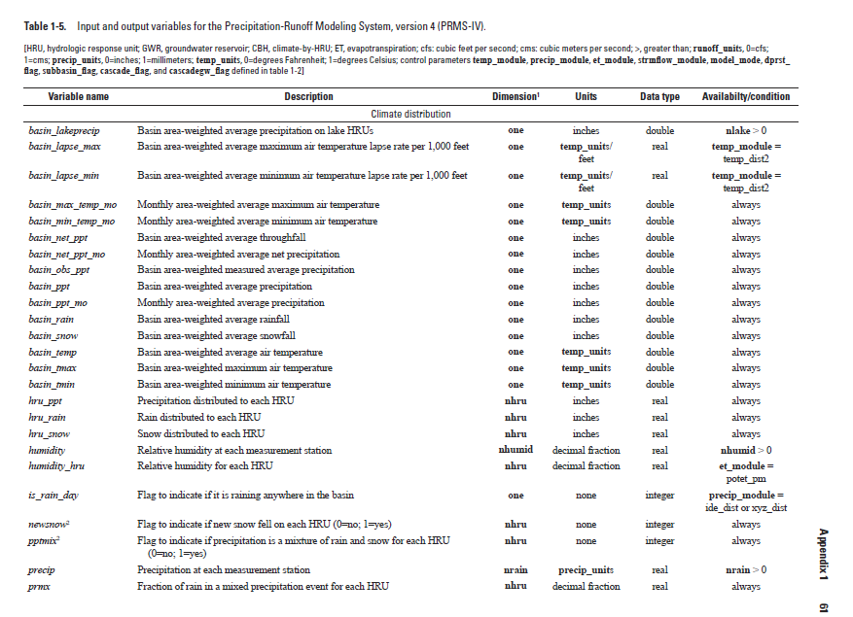
System Concepts: Variables
A value that can change each time step during the course of a PRMS simulation
“Declared” by the active modules in PRMS
Must be declared as arrays -- scalar variables have an array size of one
Input variable values of are read from the PRMS Data File as the simulation progresses
Real or integer numerical type

Slide 15
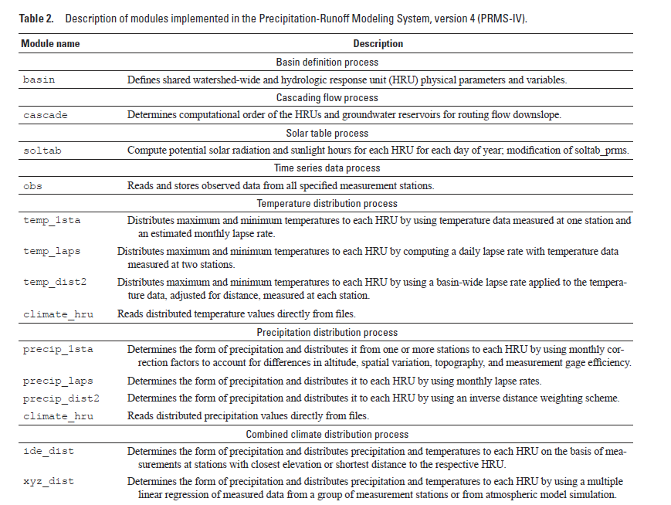
System Concepts: Processes and Modules
A “process” represents one of the major hydrological process or administrative tasks
PRMS has 17 processes

Slide 16
System Concepts: Processes
Basin definition - Defines shared watershed-wide and hydrologic response unit (HRU) physical parameters and variables
Cascading flow - Determines computational order of the HRUs and groundwater reservoirs for routing flow downslope
Solar table - Compute potential solar radiation and sunlight hours for each HRU for each day of year
Time series data - Reads and stores observed data from all specified measurement stations
Temperature distribution - Distributes maximum and minimum temperatures to each HRU
Precipitation distribution - Determines the form of precipitation and distributes it from one or more stations to each HRU
Combined climate distribution - Determines the form of precipitation and distributes precipitation and temperatures to each HRU
Solar radiation distribution - Distributes solar radiation to each HRU

Slide 17
System Concepts: Processes
Transpiration period - Determines whether the current time step is in a period of active transpiration
Potential evapotranspiration - Computes the potential evapotranspiration for each HRU for each day
Canopy interception - Computes volume of intercepted precipitation, evaporation from intercepted precipitation, and throughfall
Snow - Initiates development of a snowpack and simulates snow accumulation and depletion processes
Surface runoff - Computes surface runoff and infiltration for each HRU
Soil-zone - Computes inflows to and outflows from soil zone of each HRU
Groundwater - Sums inflow to and outflow from PRMS groundwater reservoirs
Streamflow - Computes daily streamflow as the sum of components of flow, channel routing
Summary – various output reports

Slide 18
System Concepts: Processes and Modules
A “process” represents one of the major hydrological process or administrative tasks
PRMS has 17 processes
A “module” is a piece of source code used by PRMS to simulate a process
PRMS has 39 modules
A module must be selected for each process

Slide 19
Climate Distribution Modules in PRMS
Maximum and Minimum Temperature
temp_1sta temp_laps temp_dist2
Precipitation precip_1sta precip_laps
precip_dist2
Precipitation and Temperature
climate_hru
xyz_dist
ide_dist

Slide 20
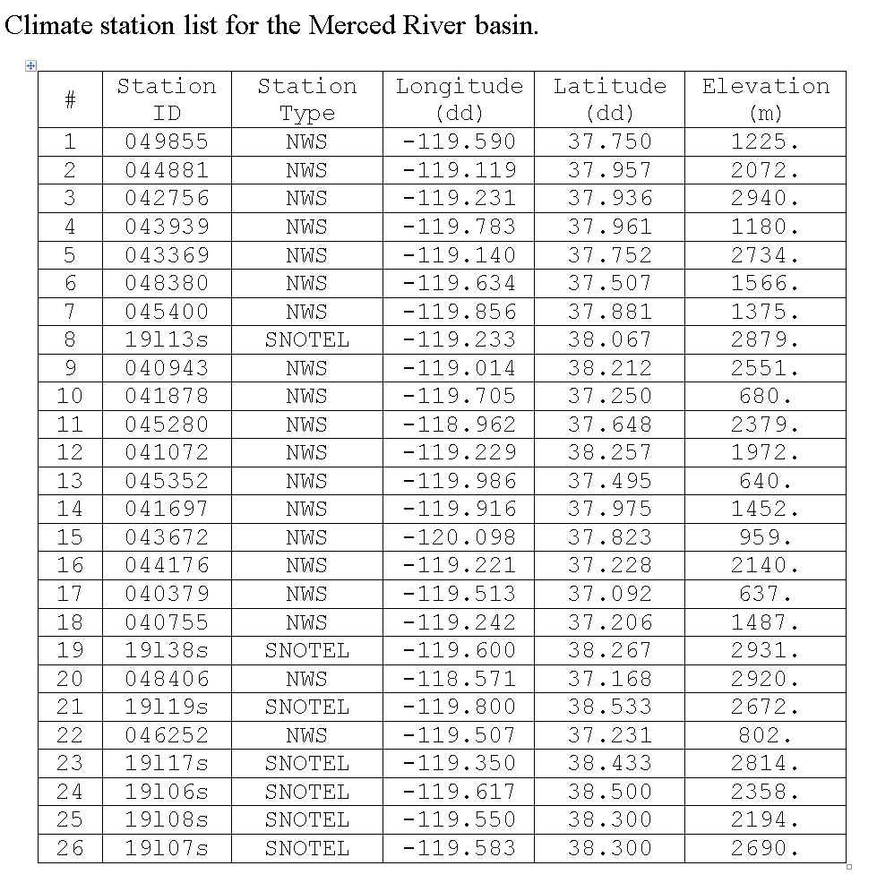

Slide 21
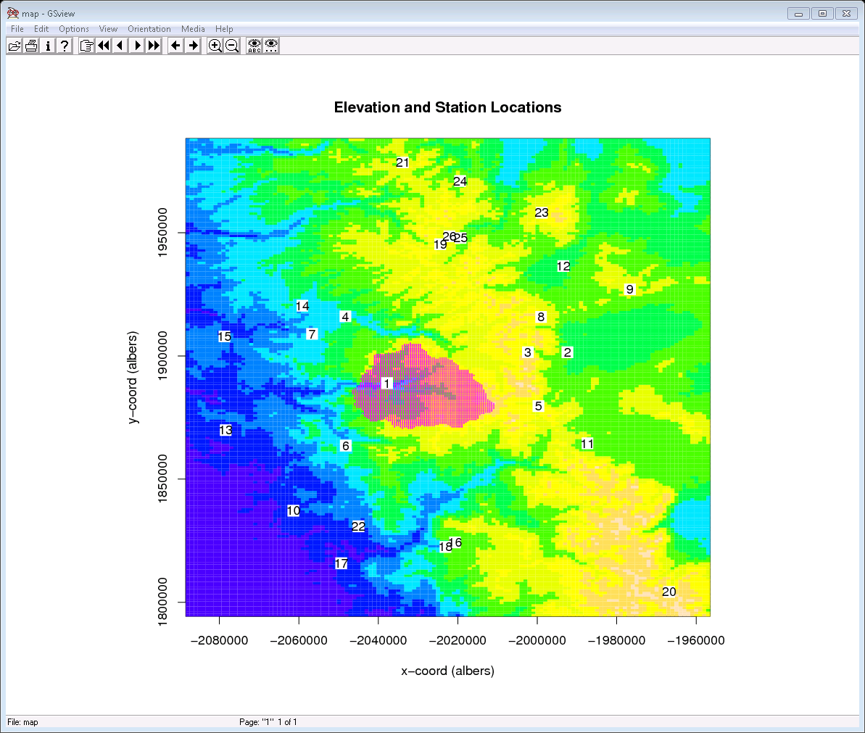
Merced River Basin, California
517 km² in area and ranges in elevation from 1200-3320m

Slide 22
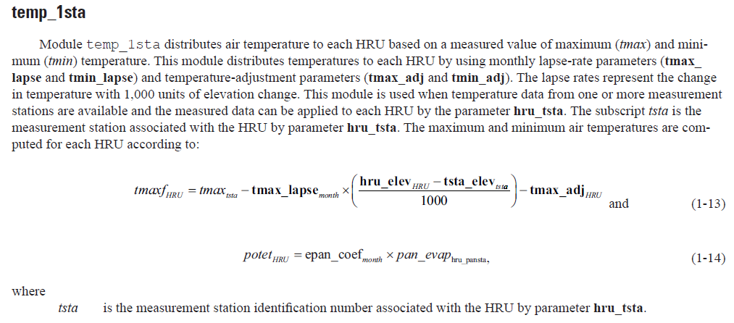
Temperature Distribution Modules
temp_1sta
Distributes air temperature to each Hydrologic Response Unit (HRU) based on a measured value
Used when temperature data from one or more measurement stations are available and the measured data can be applied to each HRU by the parameter hru_tsta.

Slide 23
Solar Radiation Distribution Modules
Uses measured solar radiation at a point and distribute it to
the HRUs using the calculated “clear sky” solar radiation.
If observed solar radiation is not available, estimate it.
Specified in the Control File by solrad_module
ddsolrad
ccsolrad
climate_hru (CBH)

Slide 24
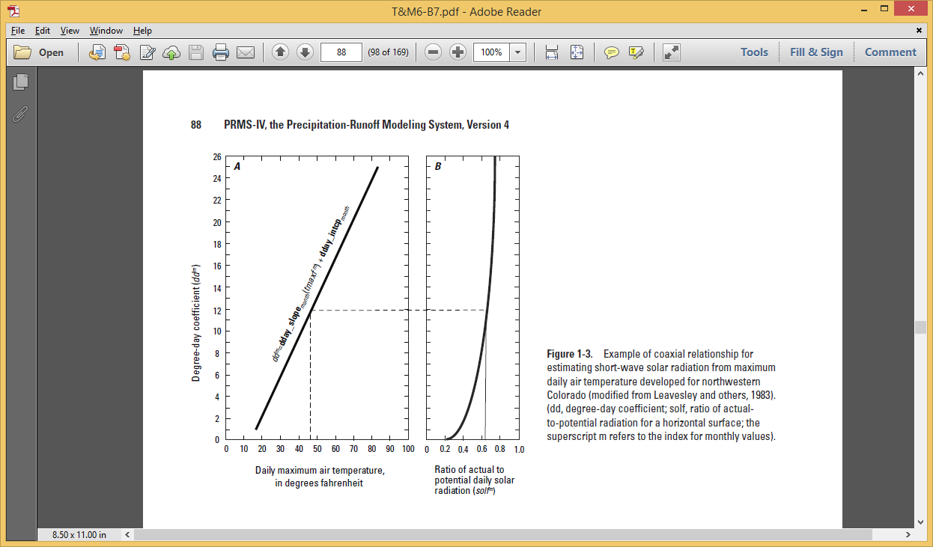
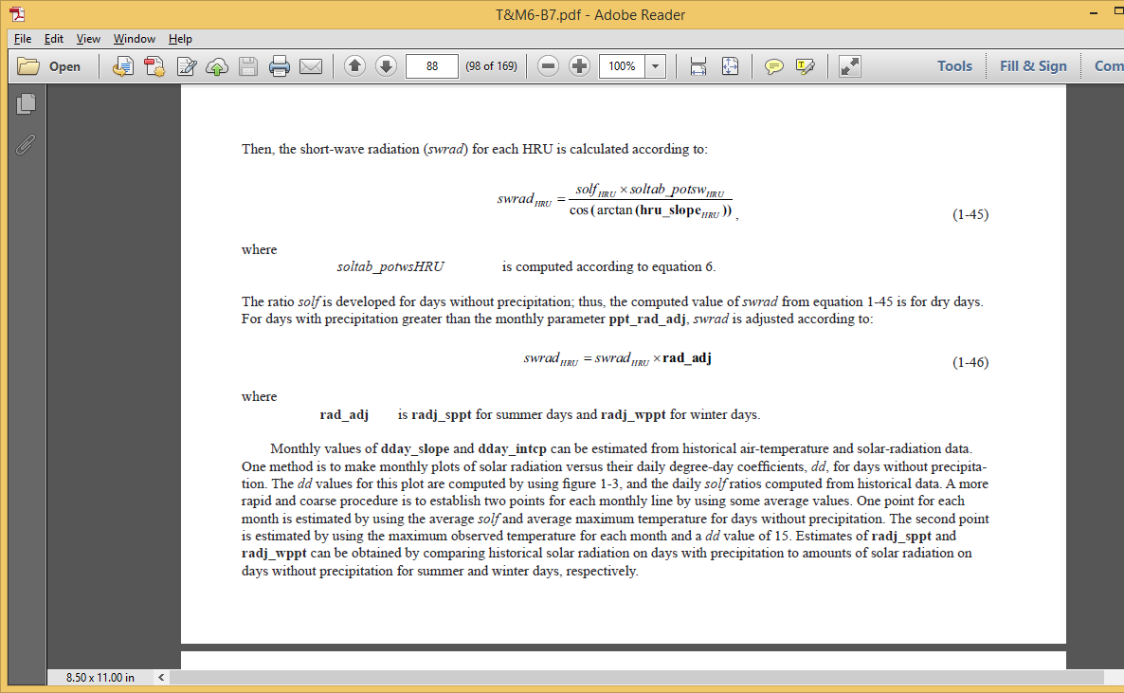
Degree-Day solf Estimation

Slide 25
Cloud Cover Solar Radiation Estimation
Estimate the amount of cloud cover on the HRU:

Slide 26
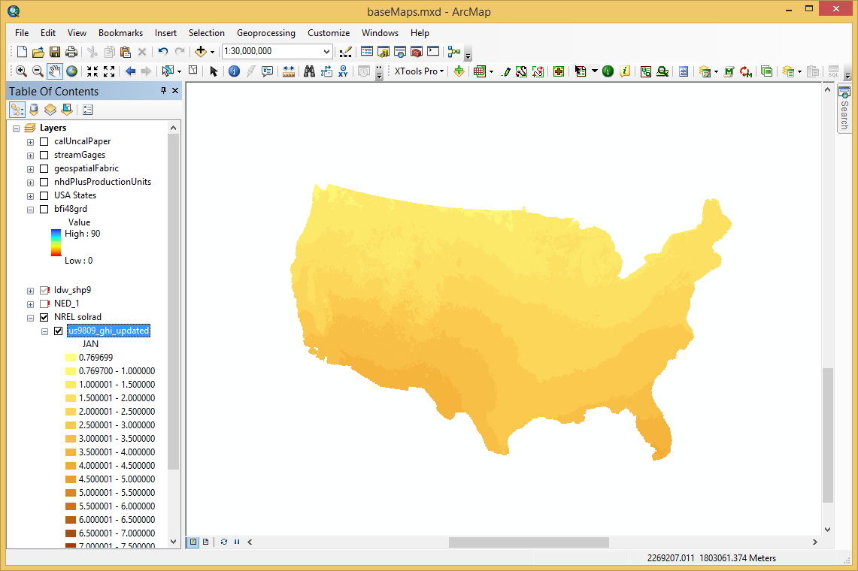
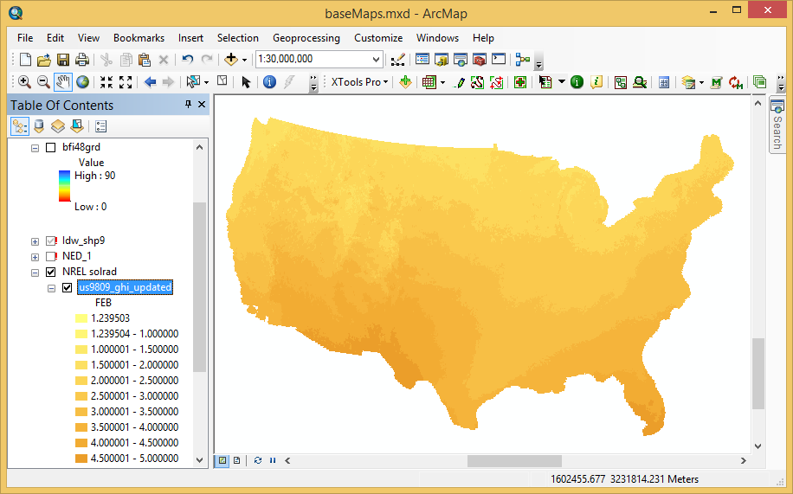
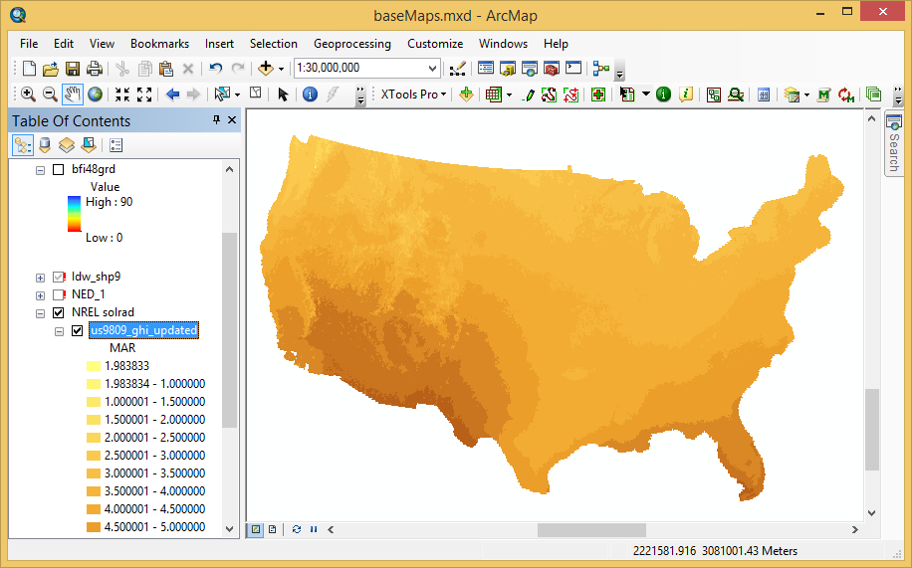
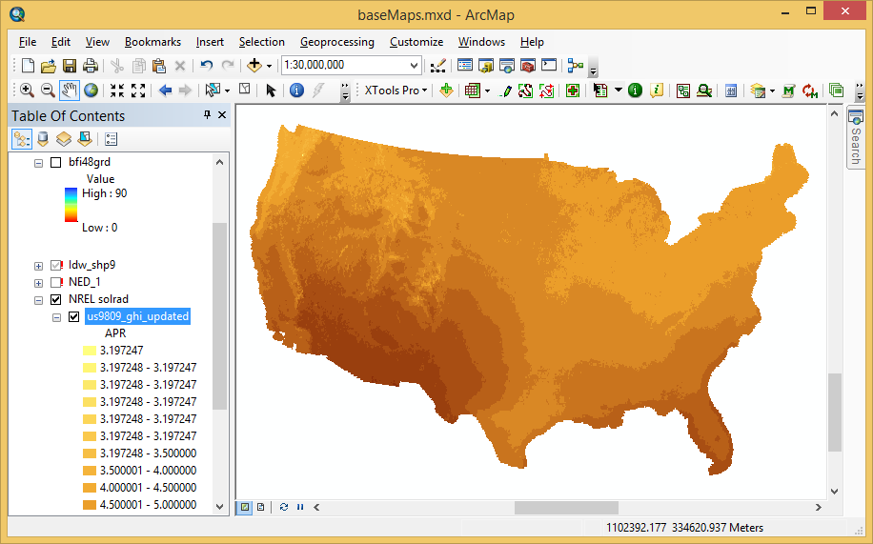
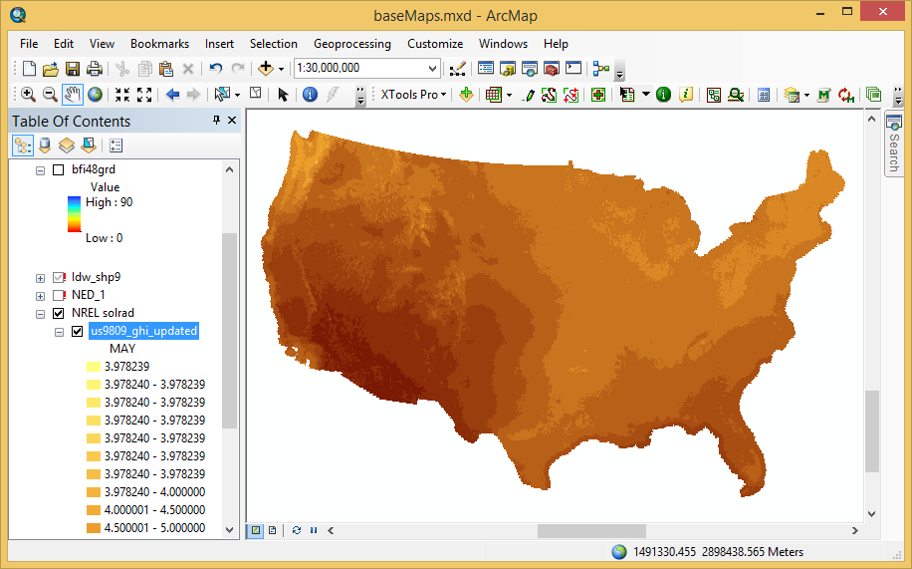
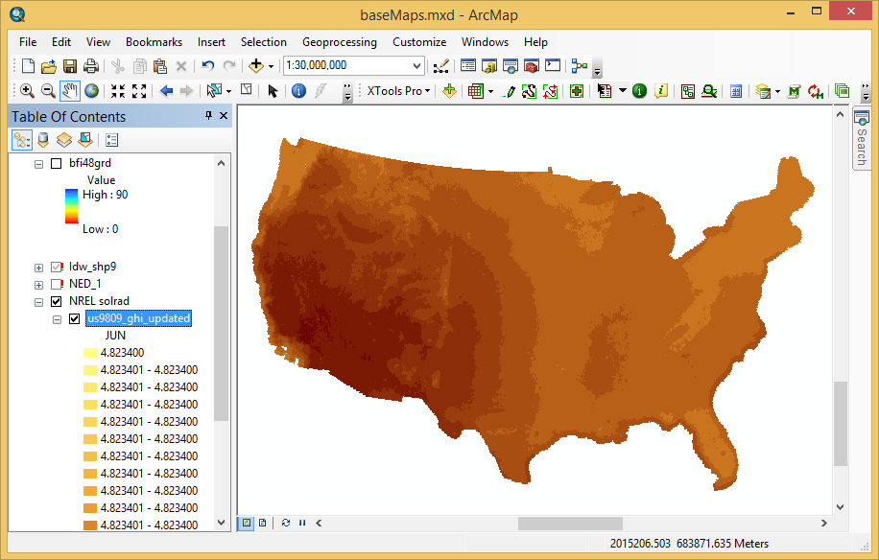
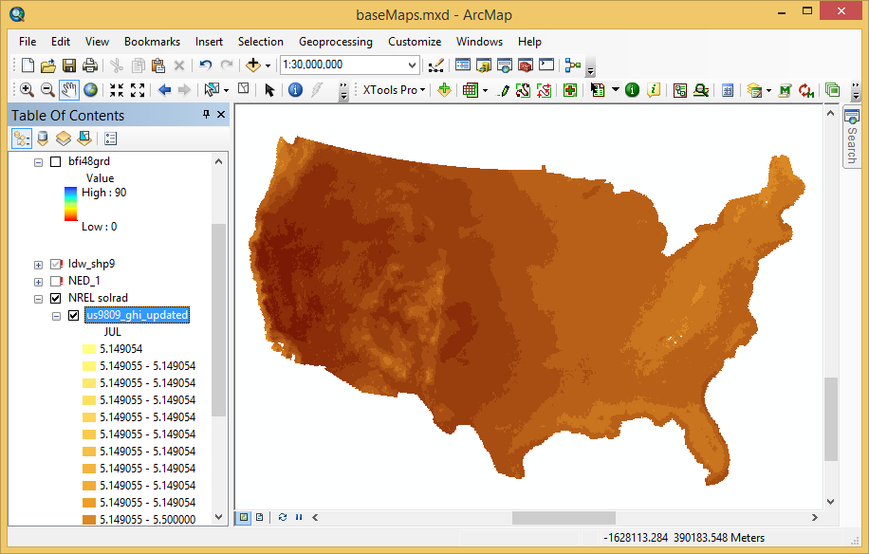
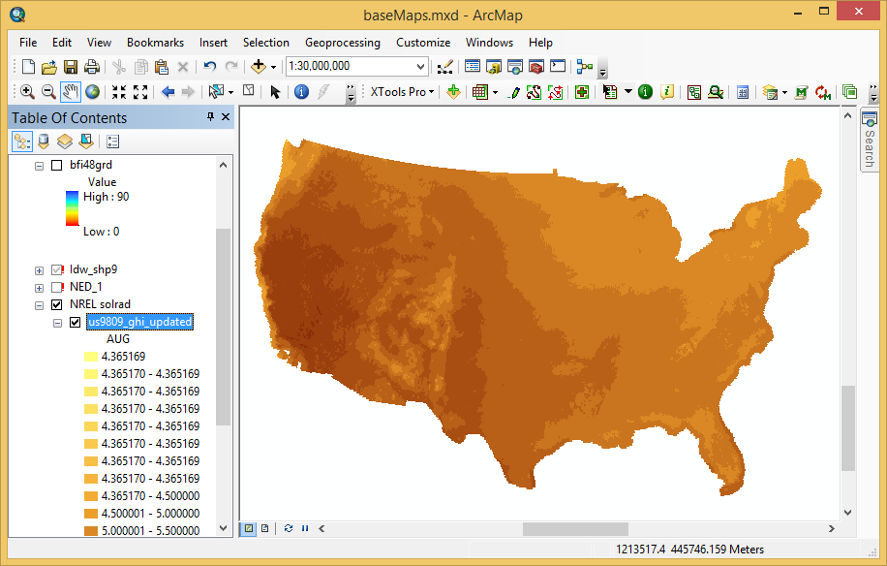
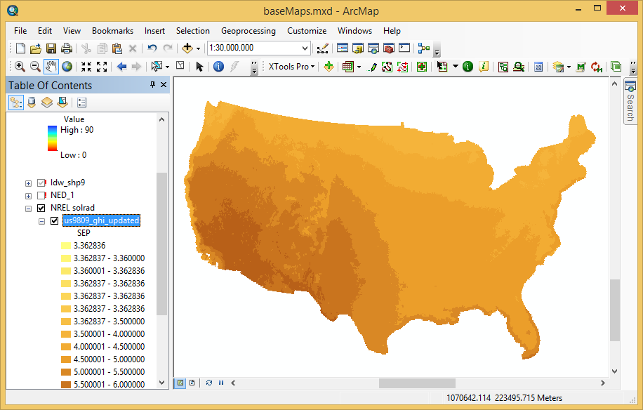

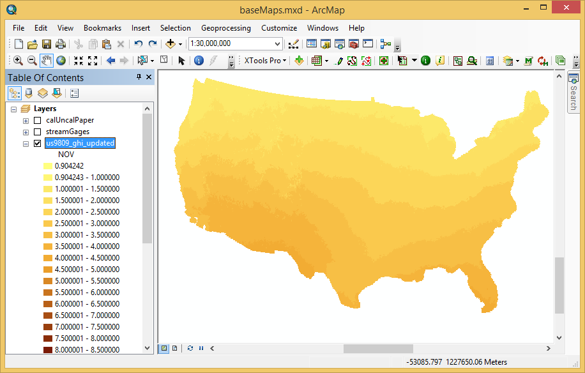
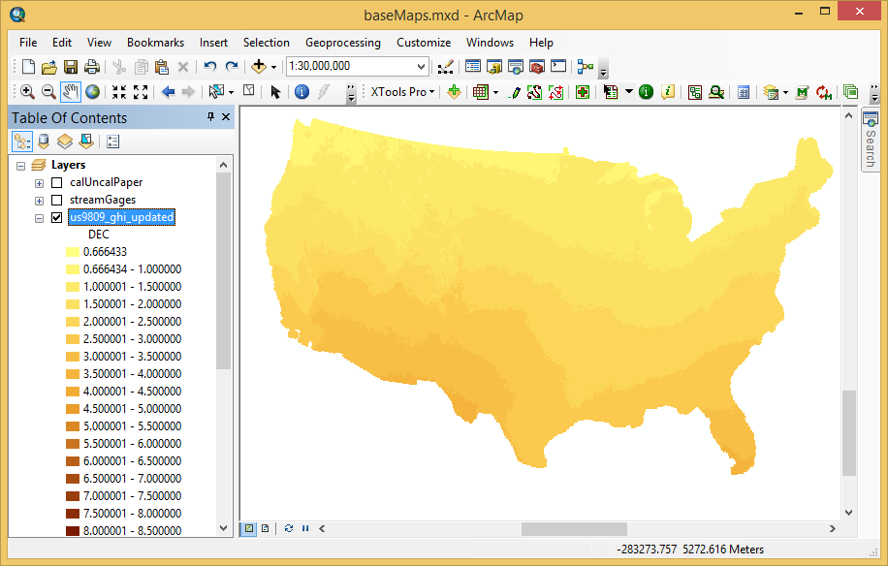
Feb
Mar
NREL Modeled Solar Radiation
Jan
Apr
May
Jun
Jul
Aug
Sep
Oct
Nov
Dec

Slide 27
Solar Radiation Modules
Units
$$1 Langley=\frac{1 calorie}{{cm}^{2}}$$
1 calorie is the amount of energy required
to raise 1 cm³ of water 1 ºC
$$\frac{1 Langley}{day}=\frac{\text{0.484583 }\text{Wat}\text{ts}}{m^{2}}$$

Slide 28
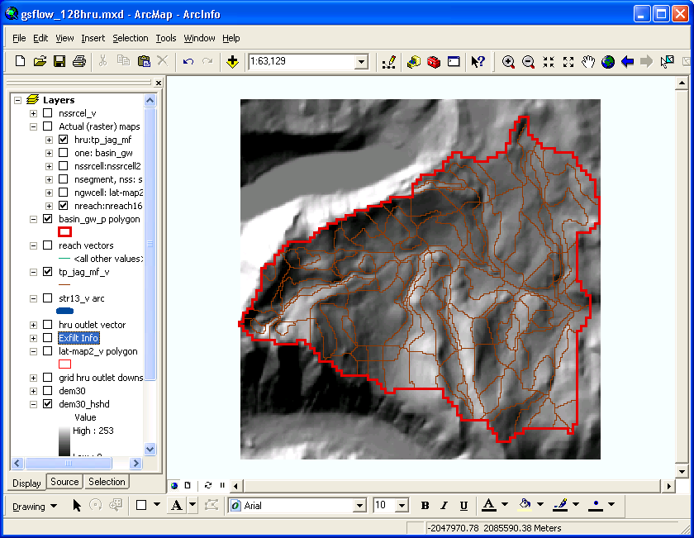
Potential ET Modules
Computes potential evapotranspiration for each HRU
potet_jh
potet_hamon
potet_hs
potet_pt
potet_pm
potet_pan
climate_hru

Slide 29
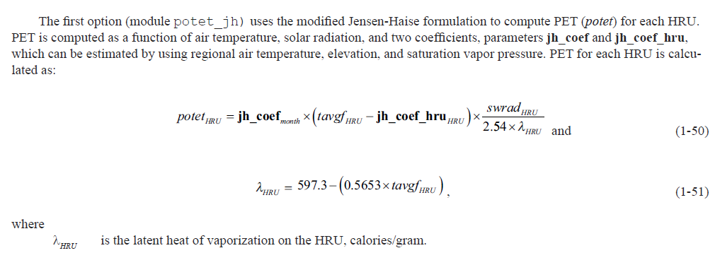
potet_jh

Slide 30
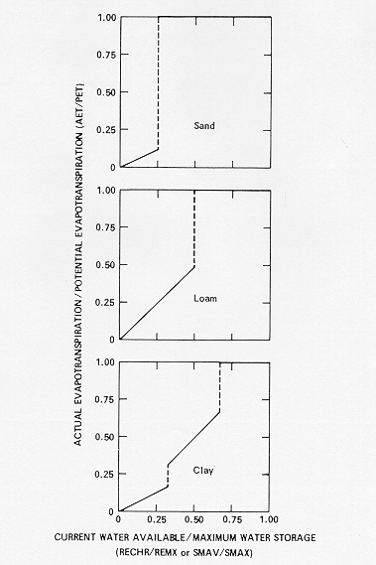
Computed ET (AET) as Function of PET and Soil Texture

Slide 31
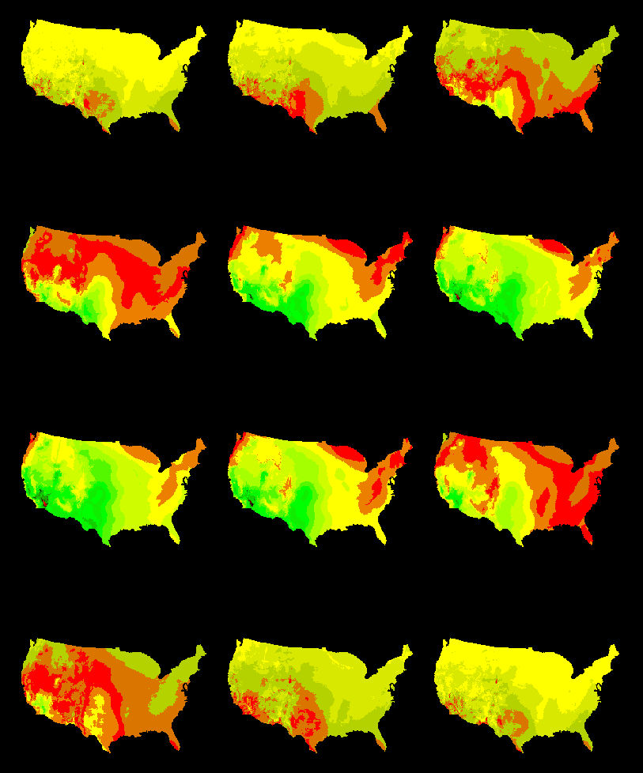
PET Maps Climatological Monthly Means (Farnsworth available on GDP)

Slide 32
snowcomp Module
Develops a snowpack and simulates snow accumulation
and depletion processes using an energy-budget approach
for each HRU
Ffrom Koczot and others, 2005

Slide 33
Snow Properties
Porous media
Undergoes metamorphosis
Surface albedo changes with time
Density increases with time
Has a free-water holding capacity

Slide 34
Snowpack Description
2-layered system
Energy balance: 2 12-hour periods
Energy exchange between layers -- conduction and mass transfer
Tsurface = min (average air temperature or 0º C)
Tpack is computed
T_{surface}
3-5 cm
Pack water equivalent depth
T_{pack}

Slide 35
Snowpack Procedure
For each HRU
Precipitation added to pack
Percent snow covered area is computed
Albedo is computed
Pack depth is computed
Pack density is computed
Energy balance for night period is computed
Energy balance for day period is computed
Sublimation is computed
Snow melt is computed

Slide 37
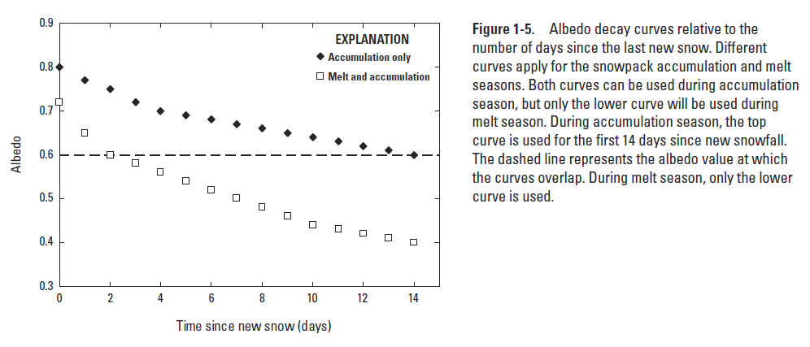
Snow Surface Albedo vs Time

Slide 38
Energy Balance Formulation
Heat available to raise the temperature of the snowpack and/or melt snow:
where tcal^{m}_{HRU} is the energy available to melt snow,
Hsn^{m}_{HRU} is the energy gained from short wave radiation,
Hln^{m}_{HRU} is the energy gained from long wave radiation,
Hc^{m}_{HRU} is the convective or sensible heat gained at the air-snow interface,
He^{m}_{HRU} is the latent heat (sublimation and condensation) gained at the air- snow interface,
Hg^{m}_{HRU} is the heat gained from the ground (assumed 0.0),
Hp^{m}_{HRU} is the heat gained from precipitation, and
Hq^{m}_{HRU} is the heat required for internal state change

Slide 39
Snow melt
snowmelt^{m}_{HRU} is the snowmelt on an HRU

Slide 40
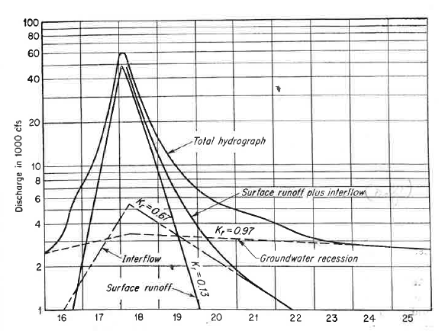




Module gwflow Baseflow Calculation
Hydrograph separation and the characteristic depletion equation (Linsley, Kohler and Paulhus):
$$q_{t}={q_{0}\left(K_{r}\right)}^{t}$$
Integration leads to storage
as a function of flow:
gwflow_coef = -ln(K_{r})
$$S_{t}=−\frac{q_{t}}{ln\left(K_{r}\right)⁡}$$
PRMS baseflow and groundwater
storage equations:
$$q_{t}={−ln\left(K_{r}\right)S}_{t}$$
$$S_{t+1}=S_{t}−q_{t}$$
q_{t}
Q_{t+1}
S_{t}
S_{t+1}
T = t
T = t+1

